Slide 1

Asking and telling the way
Maja Skakić & Dolores Malić

Slide 2
Asking the way
Excuse me. How do I get to …., please?
Excuse me. Can you tell me the way to …, please?
Excuse me. Is there a/an … near here, please?

Slide 3
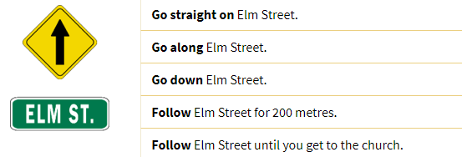
Telling the way

Slide 4


Slide 5


Slide 6


Slide 7


Slide 8


Slide 9


Slide 10


Slide 11
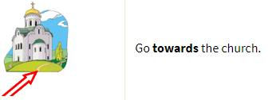

Slide 12


Slide 13


Slide 14


Slide 15


Slide 16


Slide 17


Slide 18


Slide 19


Slide 20


Slide 21


Slide 22


