Slide 1
Utrjevanje za 2. PPZ
Project 1 6. razred
Units 2 & 3 (holidays) & 4 (food)

Slide 2
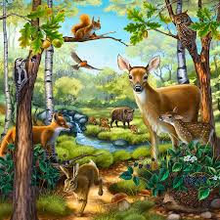
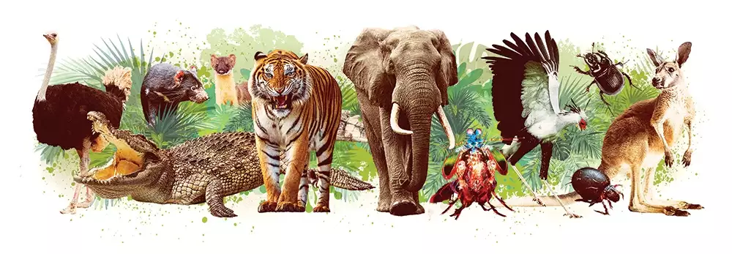
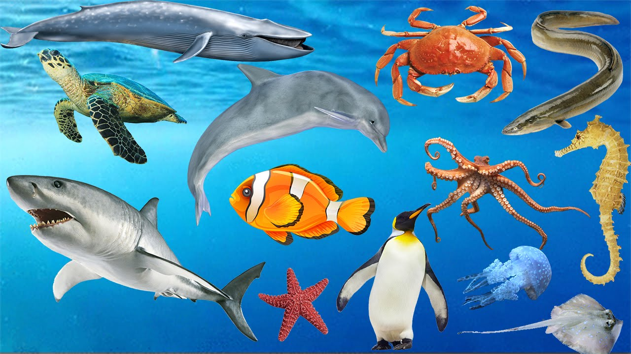
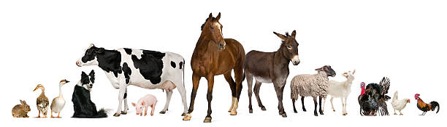
Name as many animals as you can.
POIMENUJE VSE ŽIVALI, KI JIH POZNAŠ.

Slide 3
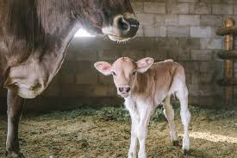
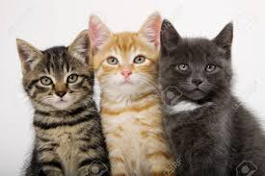
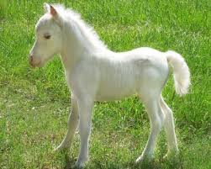
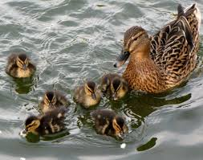
Look at the pictures and fill in. (DOPOLNI POVEDI.)
A cow usually bears a single ___________.
Our cat has got three ______________.
Every time I visit Lipica I enjoy watching little ________________ jumping around.
Oh! Look at the mother duck with her ________________. They are so cute!

Slide 4
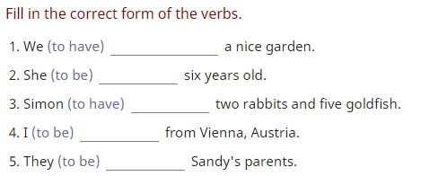
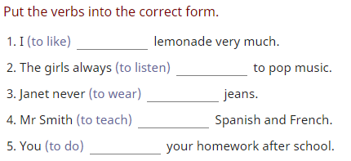
Present Simple
A)
B)

Slide 5
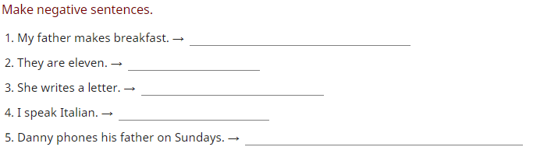
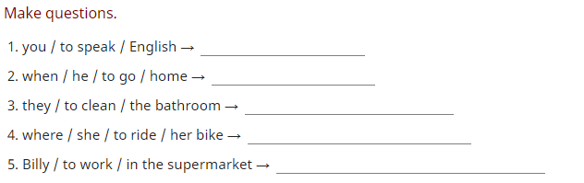
A)
B)

Slide 6
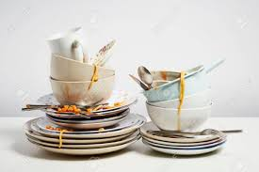
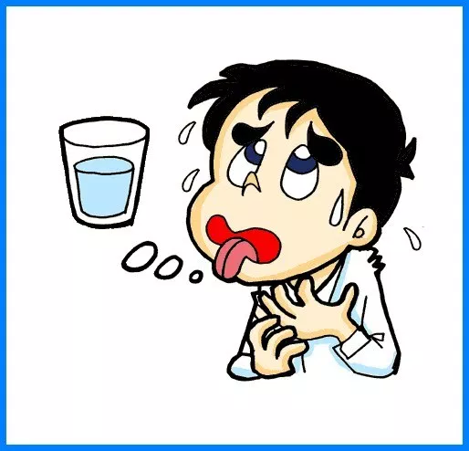
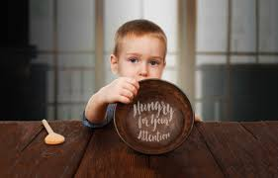
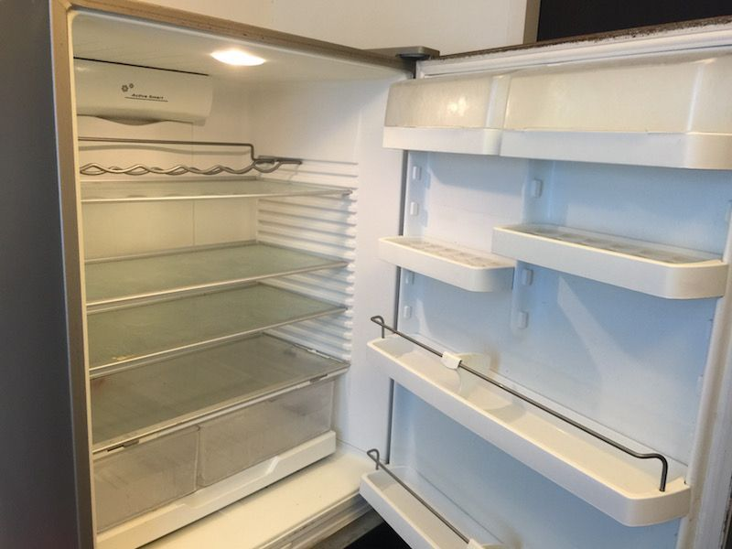
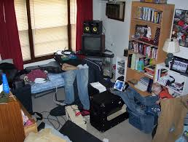
What must they do? (NAPIŠI V POVEDIH.)

Slide 7
What‘s missing? (OSEBNI ZAIMKI)
Where is the boy going? _____ is going to school.
Mary loves to cook. _____ likes baking too.
Mary and Jane are going to the store. Please ask _____ to pick up some bread.
You and I are going to the movies. _____ should go out to eat first.
Jack and Jill went up the hill. ____ like going up hills.
Jack and Jill are in town. I saw _____ in the store yesterday.
That big black spider bit me. _____ bit me on my hand.

Slide 8
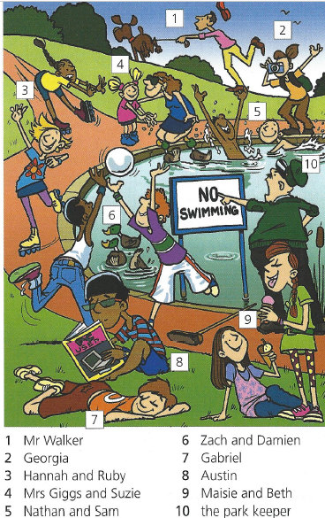
What are they doing?
(Present Continuous)

Slide 9
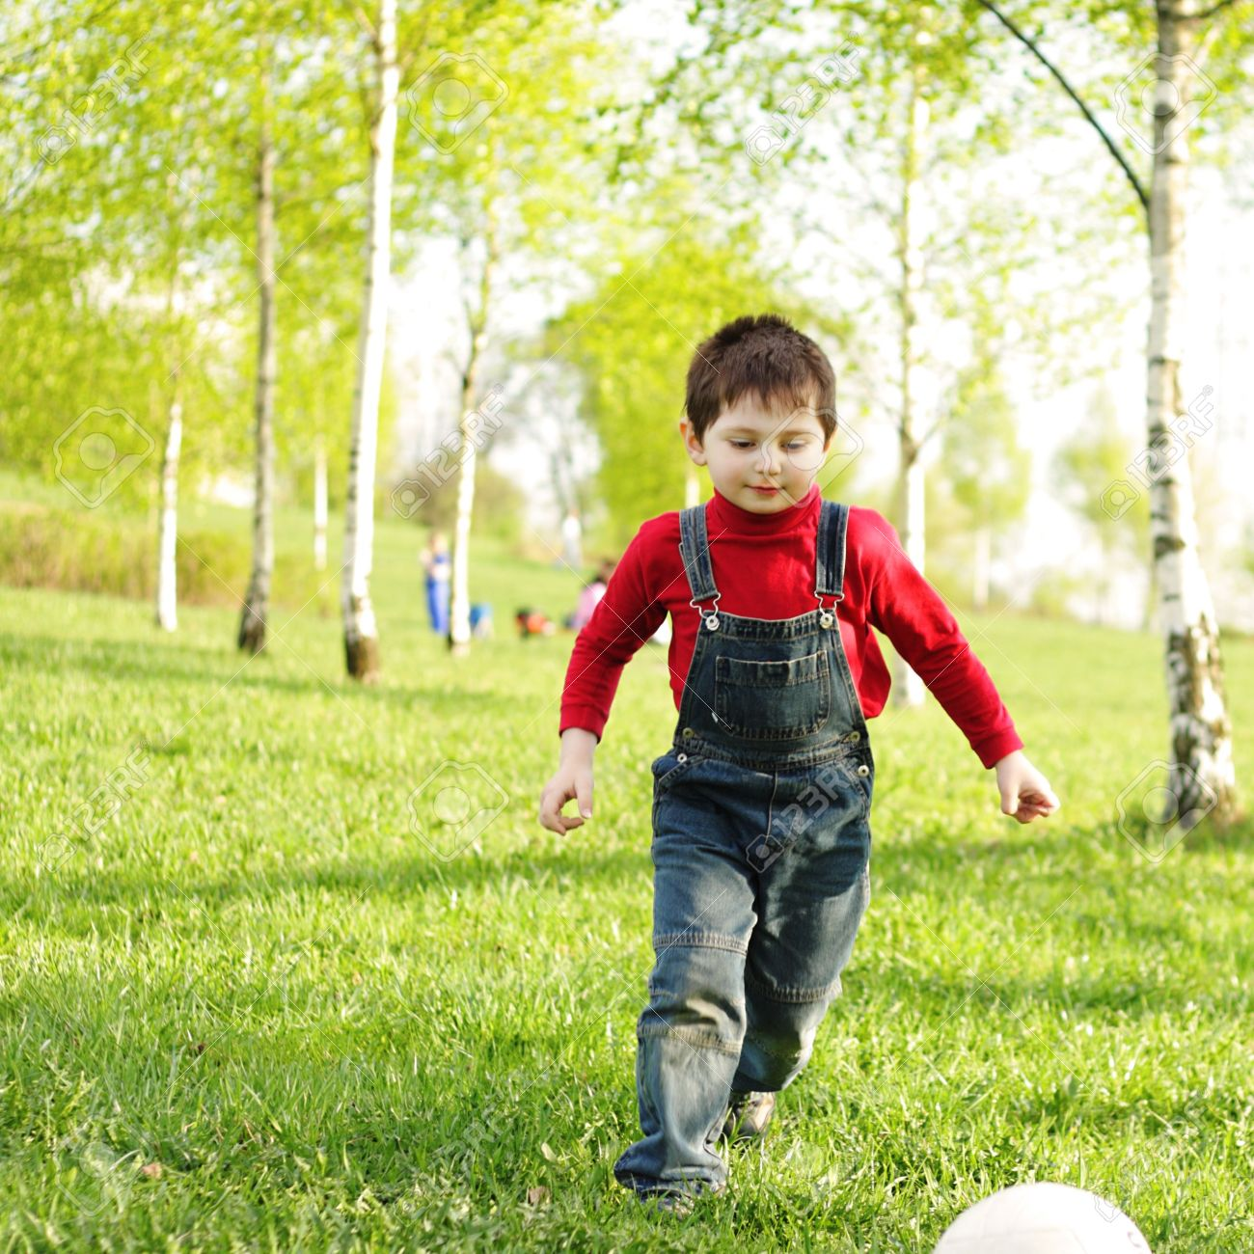
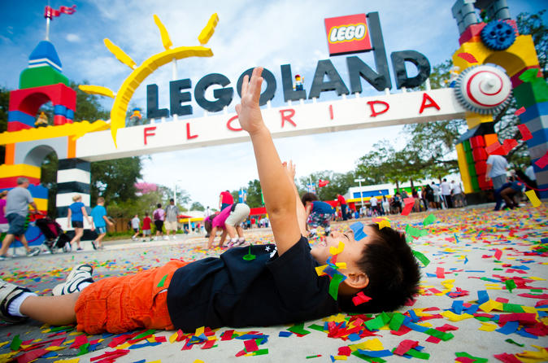
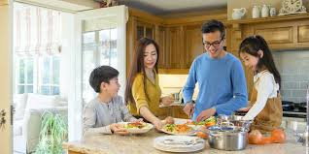
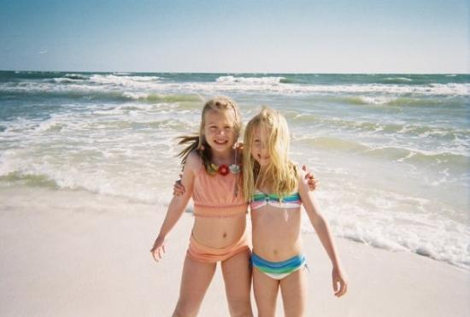
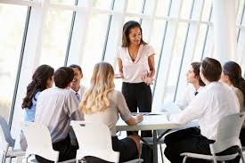
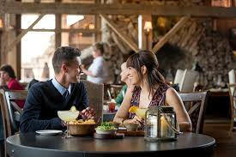
Where are they? (V POVEDIH NAPIŠI, KJE SO.)

Slide 10
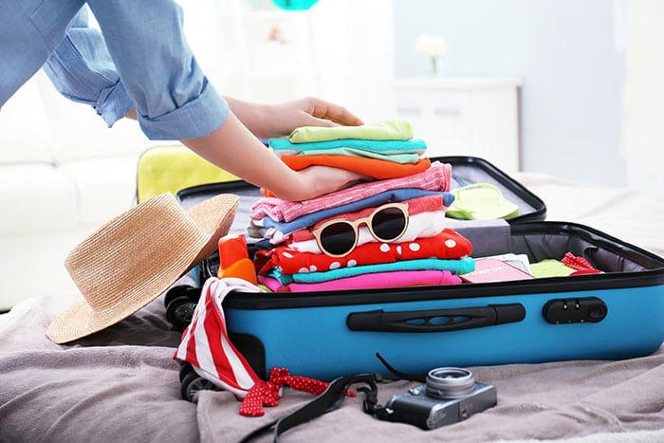
What do you need to pack, when you …
DOPOLNI – KAJ POTREBUJEŠ, KO…
… go to Portorož for a summer vacation (poletne počitnice)?
… travel abroad (v tujino)?
… go to a spa (toplice) during the winter holidays?
… go to a school camp (šola v naravi) Planinka?

Slide 11
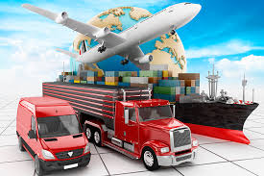
Transport (PREVOZNA SREDSTVA)
What are the ways of travelling on water? Name at least 3.
How can you travel, when you want to visit places in Slovenia? Name at least 6.

Slide 12
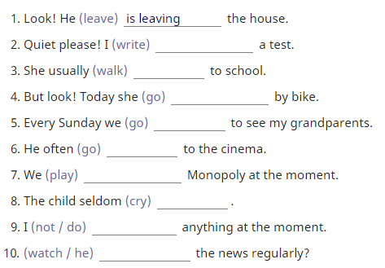
Put the verbs in Present Simple or Continuous

Slide 13
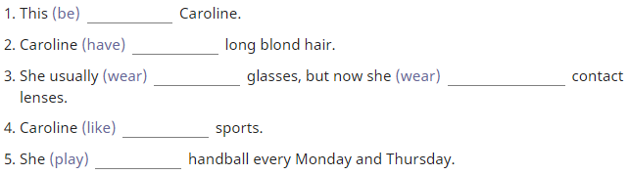
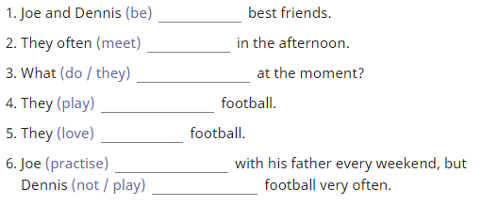
Extra practice

