Slide 1
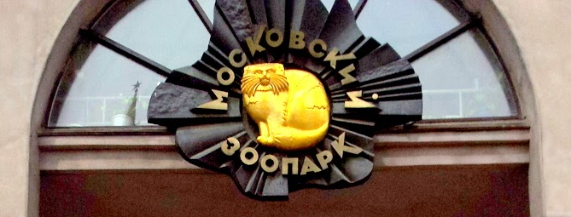
Московский зоопарк

Slide 2
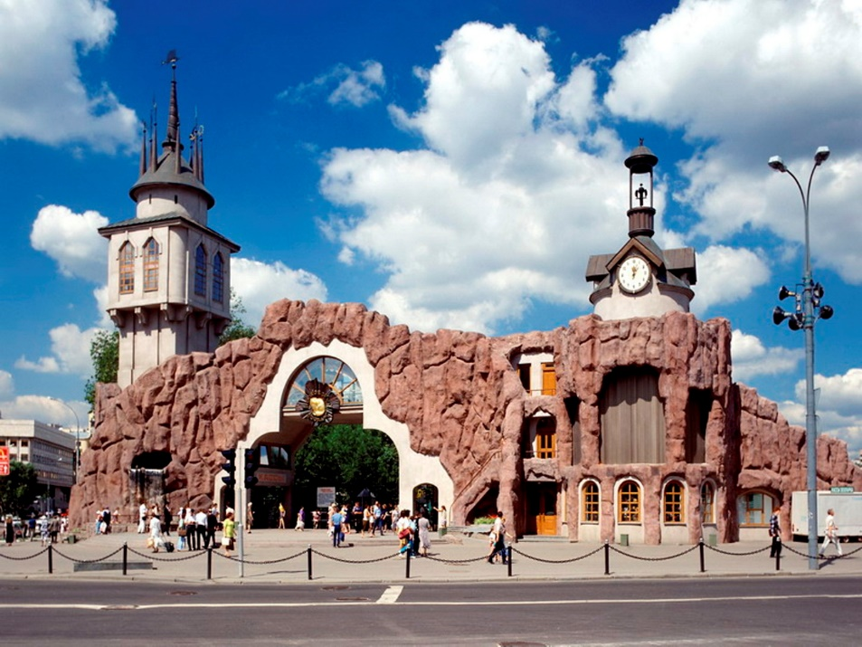

Slide 3
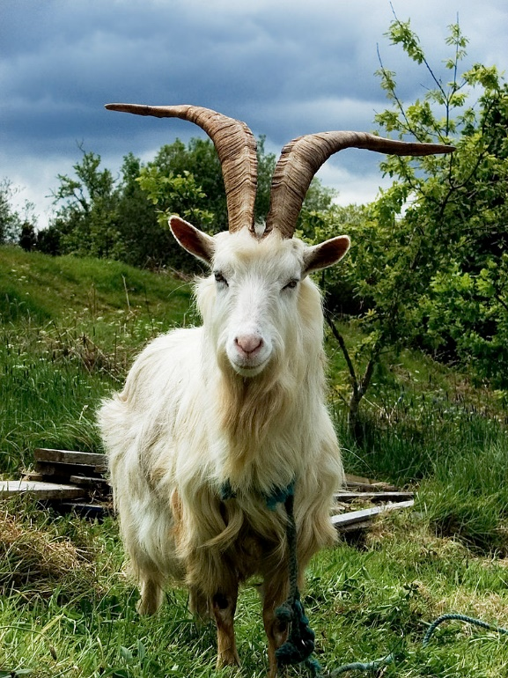
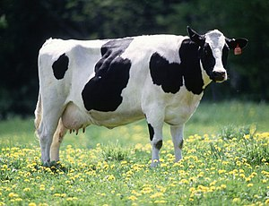
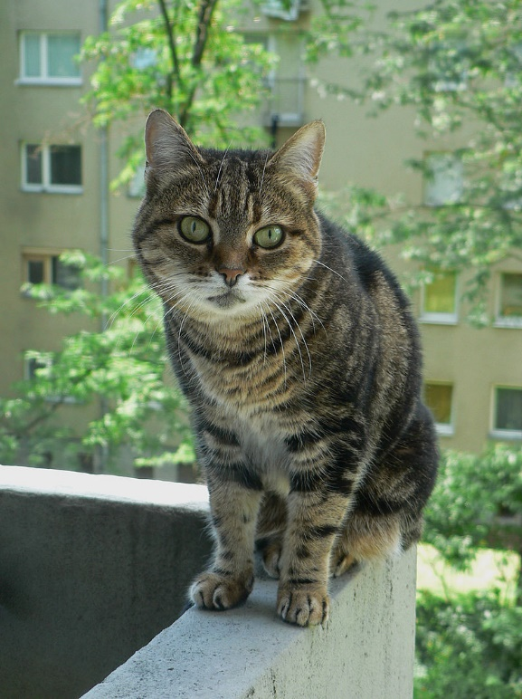
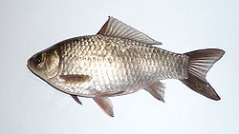
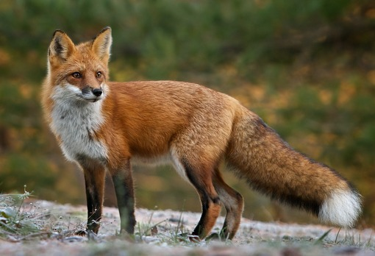
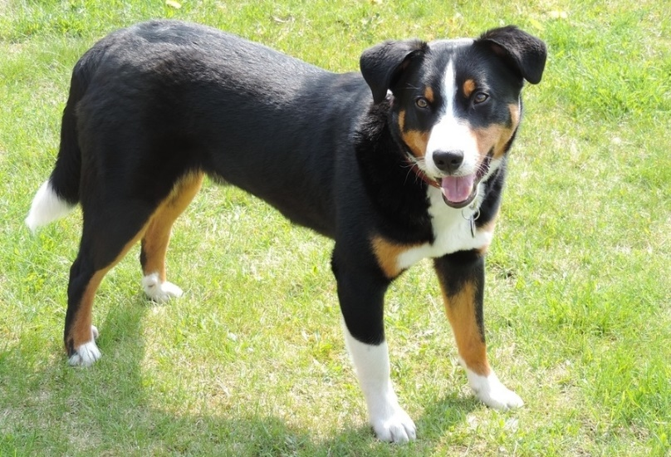
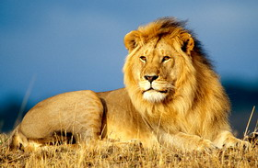

Slide 4
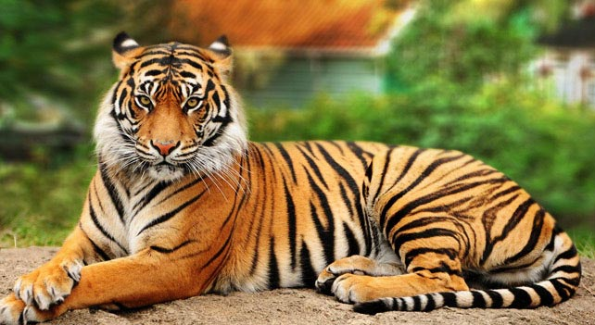
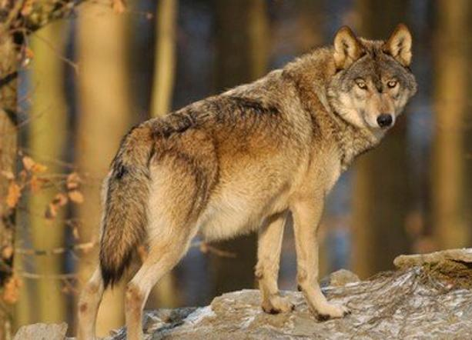
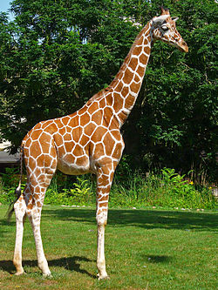
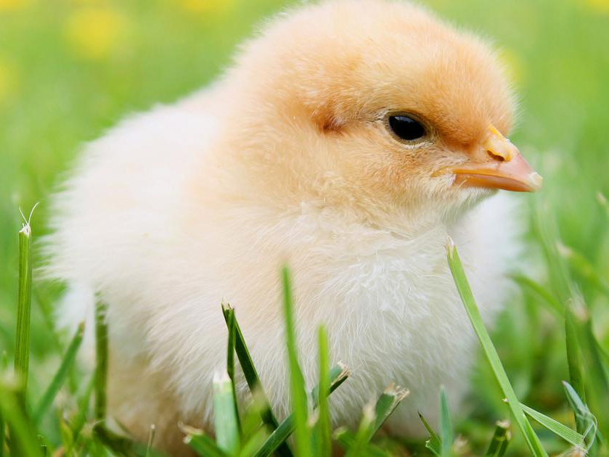
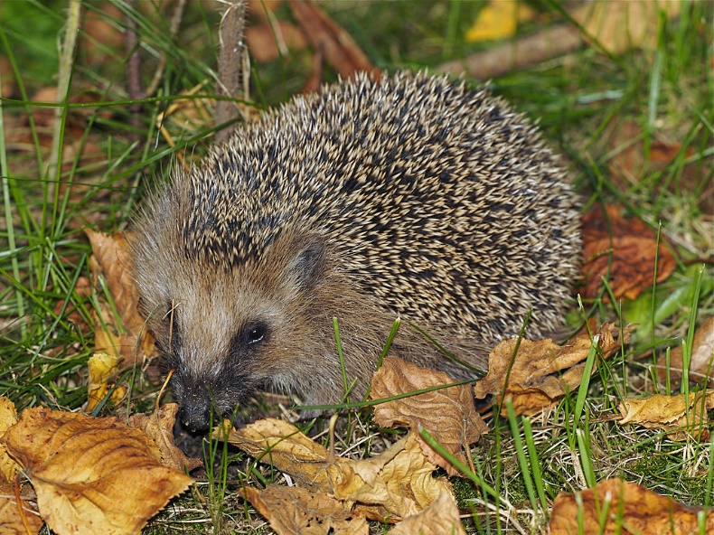

Slide 5
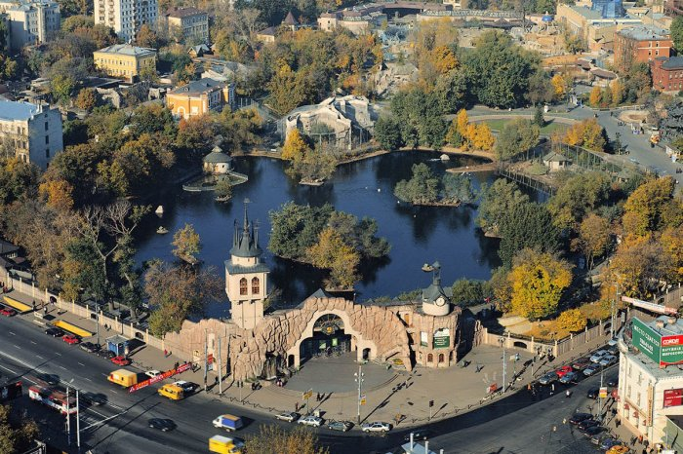

Slide 6
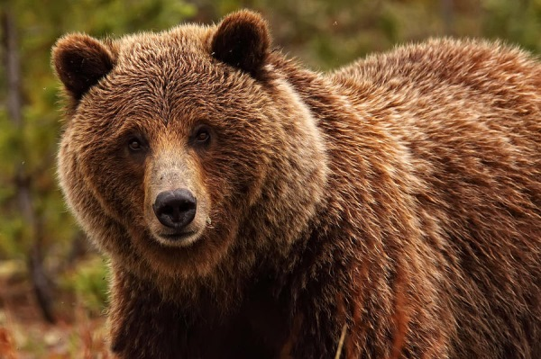
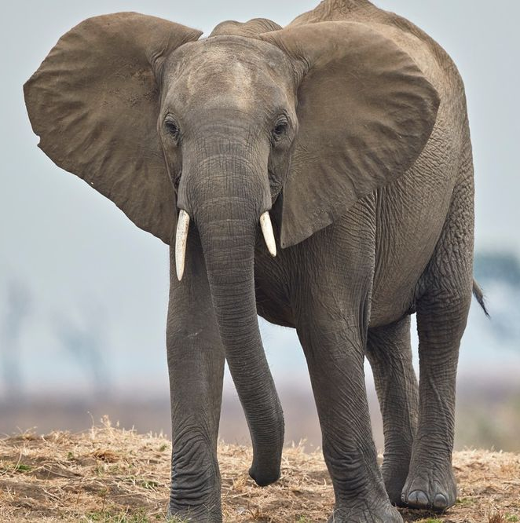
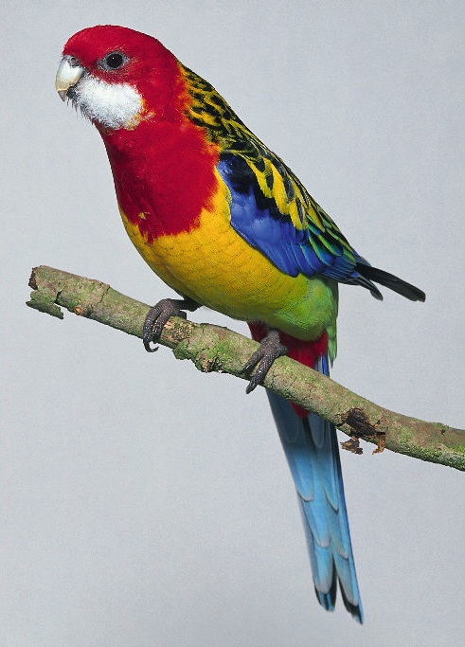
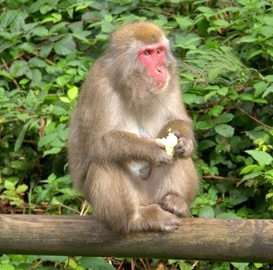

Slide 7
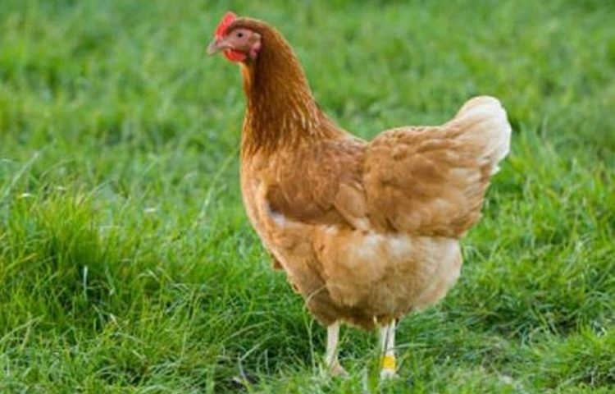
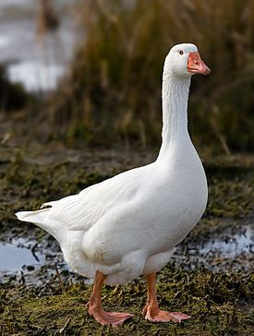
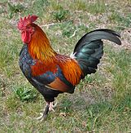
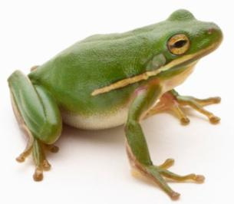
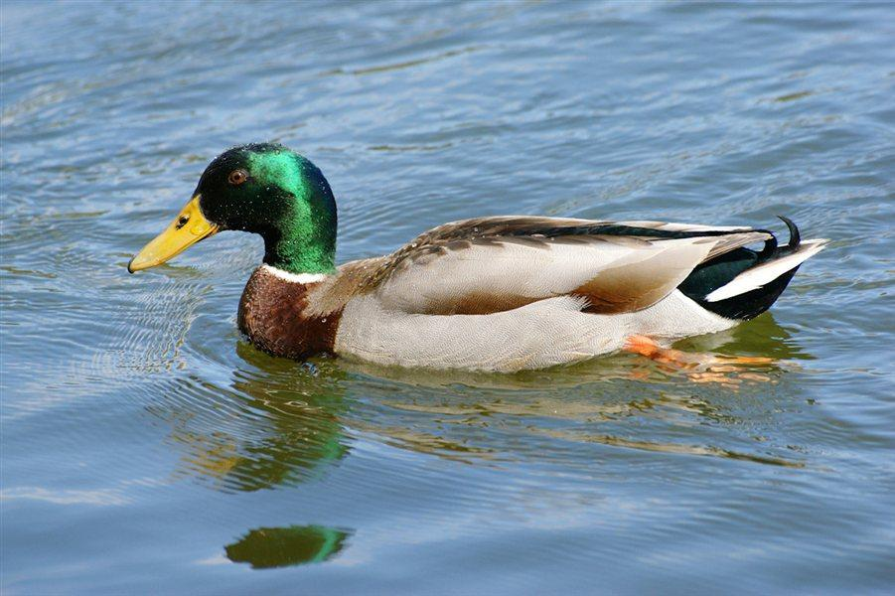
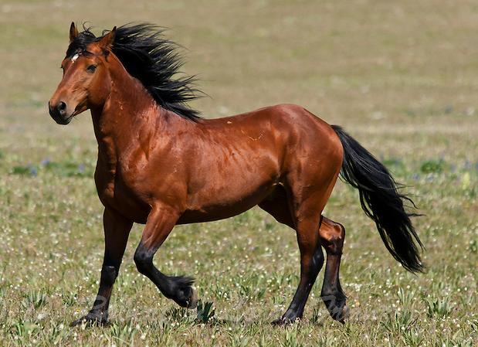
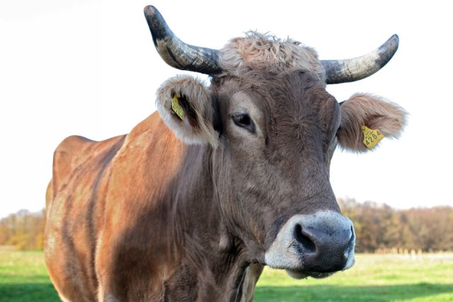

Slide 8
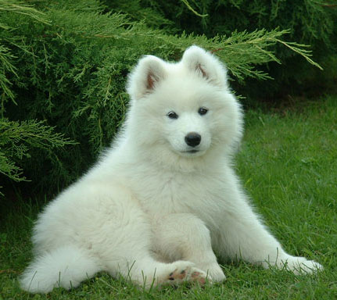
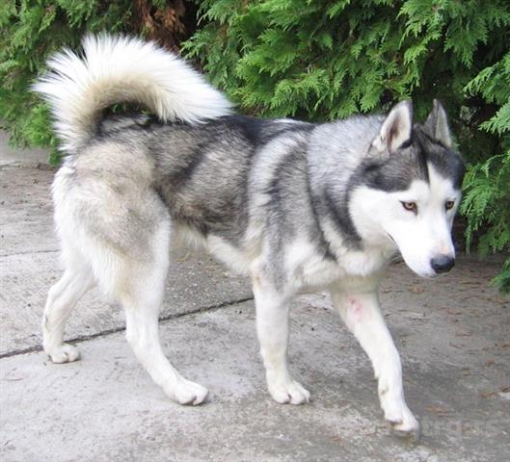

Slide 9
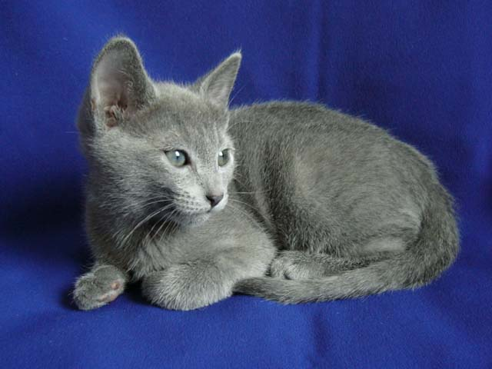
https://upload.wikimedia.org/wikipedia/commons/d/de/Russian_Blue_kitten.jpg
Zanimivost:
ruski modri mucek

Slide 10
Slikovni viri: (Slike _Zivali)
Koza: https://upload.wikimedia.org/wikipedia/commons/thumb/3/39/Irish_Goat.jpg/800px-Irish_Goat.jpg (pridobljeno 5. 1. 2019)
Krava: https://upload.wikimedia.org/wikipedia/commons/thumb/0/0c/Cow_female_black_white.jpg/300px-Cow_female_black_white.jpg (pridobljeno 5. 1. 2019)
Mačka: https://upload.wikimedia.org/wikipedia/commons/thumb/b/b6/Bajci_female_cat.jpg/800px-Bajci_female_cat.jpg (pridobljeno 5. 1. 2019)
Lev: https://static-1.mojvideo.com/foto78547-1986-55790/lev-kralj-zivali.jpg (pridobljeno 5. 1. 2019)
Lisica: http://ld-videz-kozina.si/portal/da30ffbdb187.jpeg (pridobljeno 5. 1. 2019)
Pes: https://www.mrpet.si/Images/CUV/PASME/appenzell-mountain-dog-246074_960_720.jpg (pridobljeno 5. 1. 2019)
Tiger: http://malidon.si/wp-content/uploads/2015/05/bengal-tiger-gazzing.jpg (pridobljeno 5. 1. 2019)
Volk: https://www.zurnal24.si/media/img/9f/39/956105c49daeaa24596d.jpeg (pridobljeno 5. 1. 2019)
Žirafa: https://upload.wikimedia.org/wikipedia/commons/thumb/4/4d/Giraffa_camelopardalis_reticulata_01.JPG/250px-Giraffa_camelopardalis_reticulata_01.JPG (pridobljeno 5. 1. 2019)
Jež: https://upload.wikimedia.org/wikipedia/commons/thumb/e/e1/Erinaceus_europaeus_LC0119.jpg/1024px-Erinaceus_europaeus_LC0119.jpg (pridobljeno 5. 1. 2019)
Moskovski živalski vrt: http://russia-ic.com/img/news/news_22306_n.jpg (pridobljeno 5. 1. 2019)
Moskovski živalski vrt – logotip: http://4.bp.blogspot.com/-9D1g_WJbR3Q/T9raT66s0wI/AAAAAAAAAhQ/NEtOIrUTrbQ/w1200-h630-p-k-no-nu/20120613_123827.jpg (pridobljeno 5. 1. 2019)
Moskovski živalski vrt – panorama: https://moskva.glavny.tv/sites/default/files/styles/large/public/mainphotos/91457/moskovskiy-zoopark-perehodit-na-zimnee-vremya-104043.jpg?itok=TkC9s6Tr (pridobljeno 5. 1. 2019)
Doktor Jojboli: https://ds02.infourok.ru/uploads/ex/054b/00039b42-3aff1bd0/hello_html_m19fe9dad.jpg (pridobljeno 5. 1. 2019)
Riba: https://upload.wikimedia.org/wikipedia/commons/thumb/5/57/Carassius_gibelio_2008_G1.jpg/250px-Carassius_gibelio_2008_G1.jpg (pridobljeno 7. 1. 2019)
Piščanec: http://svetkapitala.delo.si/media/img/81/49/8cdd7fb1a2feb99afbbe.jpeg (pridobljeno 7. 1. 2019)
Sibirski haski: https://media.mojtrg.rs/Image/f4c2c616a9d2482fb559d89ddd36cb2d/20140308/false/false/640/480/Sibirski-Haski-mu%C5%BEjak-za-parenje.jpeg (pridobljeno 7. 1. 2019)
Samojed: https://media.mojtrg.rs/Image/f4c2c616a9d2482fb559d89ddd36cb2d/20140308/false/false/640/480/Sibirski-Haski-mu%C5%BEjak-za-parenje.jpeg (pridobljeno 7. 1. 2019)
Medved: https://www.rfantasy.si/media/thumb600/e978058f-4cae-4690-817a-8f147f670e46.jpg (pridobljeno 7. 1. 2019)
Slon: https://www.kurir.rs/data/images/2017/06/03/14/1202109_profimedia0334239631_ls.jpg (pridobljeno 7. 1. 2019)

Slide 11
Papagaj: http://1.bp.blogspot.com/-RD3PkLEYK-0/TqFVOjwVetI/AAAAAAAAAQE/JiWQPups4dQ/s1600/959582.JPG (pridobljeno 7. 1. 2019)
Opica: https://www.nina-travels.com/wp-content/uploads/2015/09/macaque-monkeys-villach-austria1.jpg (pridobljeno 7. 1. 2019)
Kokoš: https://aktualno.hr/wp-content/uploads/2017/03/kokos-750x480.jpg (pridobljeno 7. 1. 2019)
Petelin: https://upload.wikimedia.org/wikipedia/commons/thumb/1/1b/Rooster-1.jpg/220px-Rooster-1.jpg (pridobljeno 7. 1. 2019)
Domača gos: https://upload.wikimedia.org/wikipedia/commons/thumb/3/39/Domestic_Goose.jpg/275px-Domestic_Goose.jpg (pridobljeno 7. 1. 2019)
Raca: http://clanki.kupimprodam.si/wp-content/uploads/2013/05/Reja-Rac.jpg (pridobljeno 7. 1. 2019)
Vol: http://www.prijatelji-zivotinja.hr/data/image_3_4468.jpg (pridobljeno 7. 1. 2019)
Konj: http://malidon.si/wp-content/uploads/2015/06/mustang.jpg (pridobljeno 7. 1. 2019)
Žaba: https://c1.staticflickr.com/8/7218/7031846807_05acf296c5.jpg (pridobljeno 7. 1. 2019)

